Slide 1

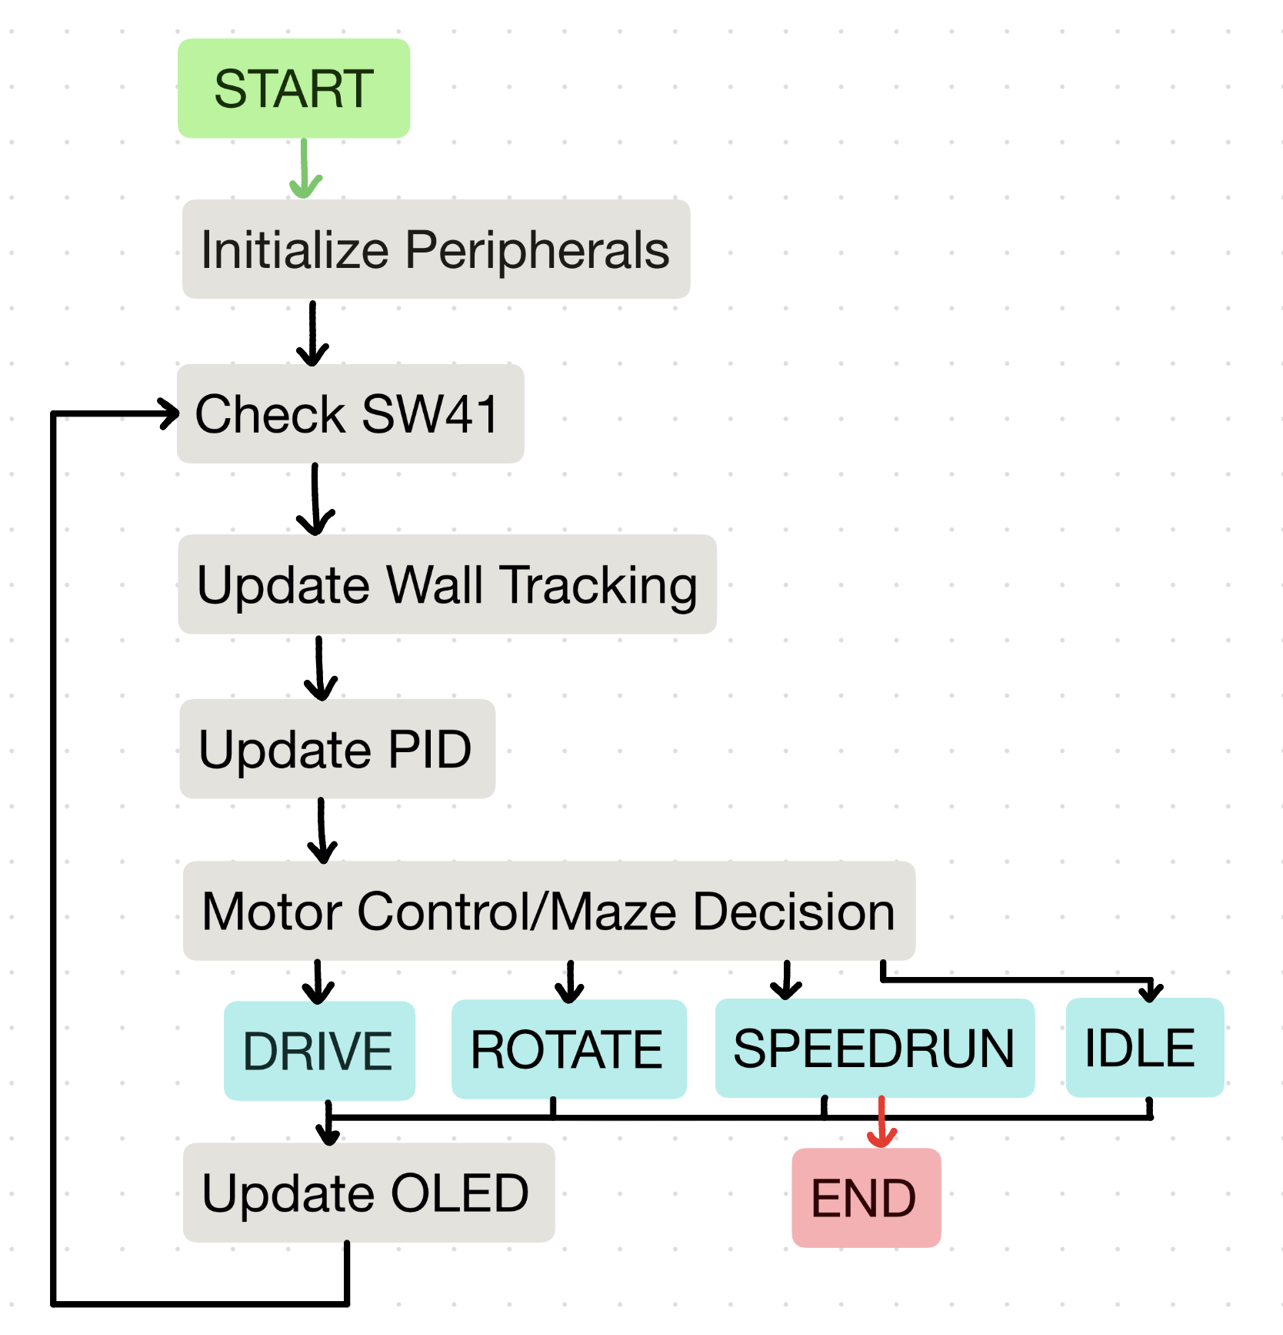
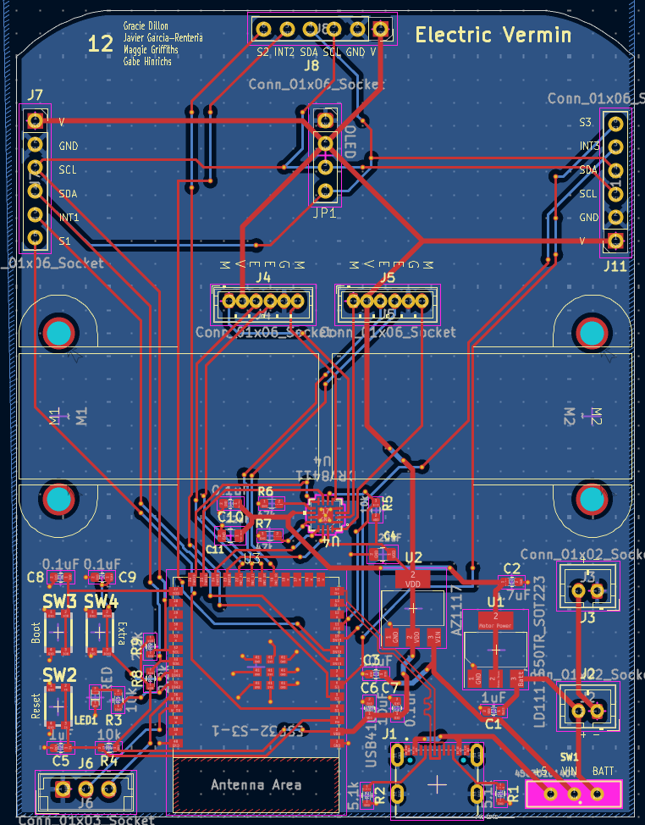
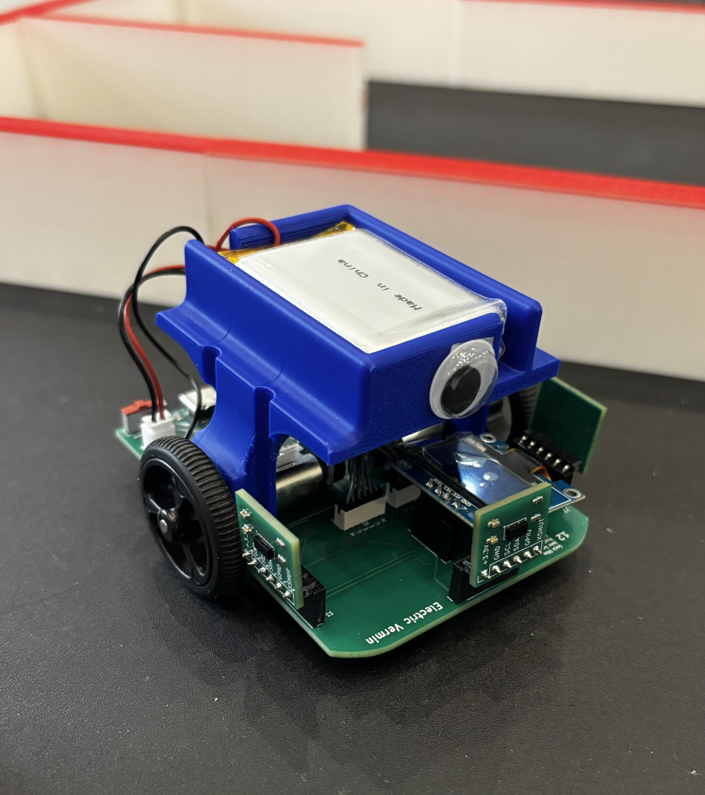
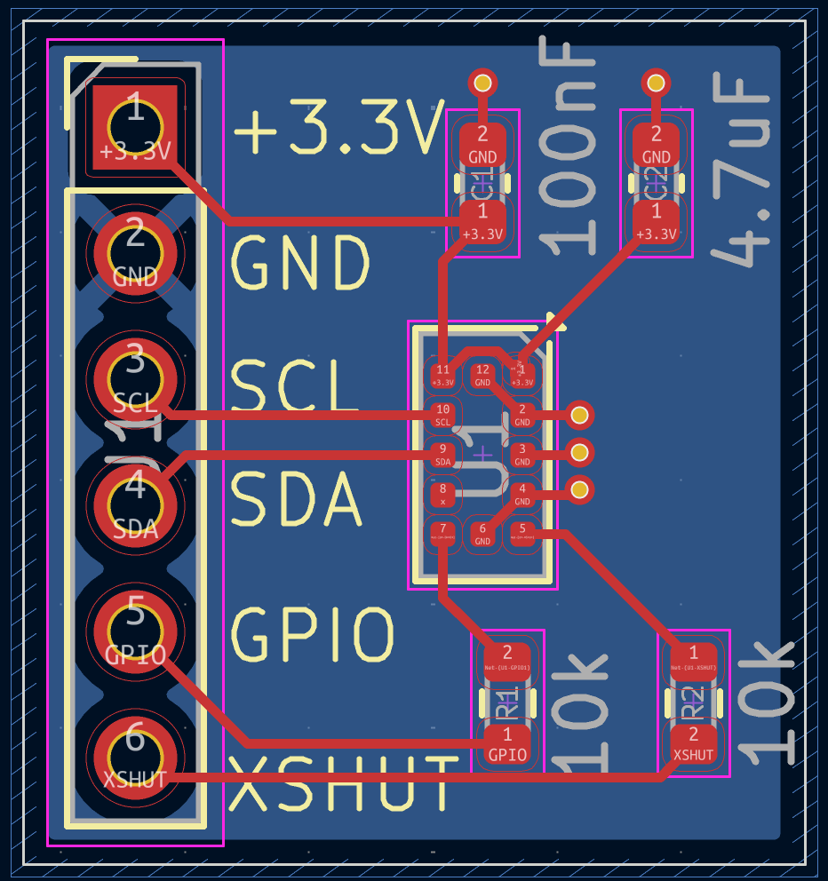
Team 12 - Electric Vermin
Gracie Dillon, Javier Garcia-Renteria, Maggie Griffiths, Gabe Hinrichs
Dr. Michael Schafer, Electrical Engineering Senior Design
Hardware
Software
Results
DRV8411A Motor Driver: This dual H-bridge motor driver efficiently and precisely controls the direction and speed of two DC motors using PWM signals.
N20 DC Motors with Magnetic Encoder
(6 V, 50:1 Gear Ratio): We placed a motor on each side of the main board, enabling the mouse to move. We use the encoders to measure wheel rotation and to track the mouse’s location. The gear ratio provides adequate torque for reliable movement.
VL53L0X ToF Sensors: We placed a sensor on the front, left, and right sides of the main board facing outward. Although ToF sensors do not update as fast as IR sensors, we preferred their reliability in varying lighting conditions.
ESP32-S3 Microcontroller: Communicates with various components, stores information about the maze, and implements maze solving algorithm.
Power: Provided by two 3.7 V Lithium ion batteries.
Dual PID Controller
ENCODER | WALL CENTERING
Tracks left/right wheel count difference and corrects the motor PWM to keep both wheels in sync. | Uses left and right ToF readings to compute lateral error and steer between the walls. Decays rapidly in open cells to avoid over-correction from stale readings.
Using our chosen hardware, we were successfully able to lead our robot to the center of the maze by developing code for maze traversal and implementing a flood fill algorithm.
Some Challenges Encountered:
At first, we chose motors with a higher gear ratio, but later purchases lower gear ratio motors to increase speed. (However, our mouse is still on the slower side due to sensor limitations.)
We experienced some trial and error assembling our board with the EIH Pick-and-Place Machine–mostly with solder bridges between small parts.
Originally, we chose to do depth-first search algorithm, but discovered it was too slow.
Figure 3. Block Diagram of Code Used for Maze Traversal
Two-phase Strategy
EXPLORATION | SPEED RUN
Navigates the full maze using an optimistic flood-fill. Unknown cells are assumed open. Records all walls and confirms every passage driven through. U-turns at the goal and returns to the beginning. | Only using passages it actually drove through and not making any assumptions based on unvisited cells, the mouse uses a flood fill algorithm to compute the shortest route from (0,0) to the goal. This path is stored as a list of directions. If a path is found, the mouse will begin taking the shortest found path after the button is pressed.
Figure 2. Wall Sensor Board PCB Design
Figure 1. Main Board PCB Design
Figure 4. Our Final Mouse Robot
Notes:
‹#›

